Slide 1


Project Title : Speech Emotion Recognition Using CNN
Trichy Engineering College
Presented by :
Harimugunthan M (814620104011),
Madhavan K M (814620104016),
Nishanth S (814620104019),
Mayesh A (814620104306).
Project Guide:
Mrs. Arasai, AP and HOD(CSE).

Slide 2
Contents:
Introduction
Aim
Abstract
Literature review
Existing methodology & Proposed methodology
System requirements
Implementation
Project Execution
Conclusion & Future work

Slide 3
Introduction:
What is SER?
Speech Emotion Recognition is a branch of Human Computer Interaction(HCI),which deals with recognizing emotional states from human speech.
For example: Happy, Sad, Angry etc.
Some of its application are in marketing, healthcare, customer satisfaction, gaming experience improvement, social media analysis, stress monitoring.

Slide 4
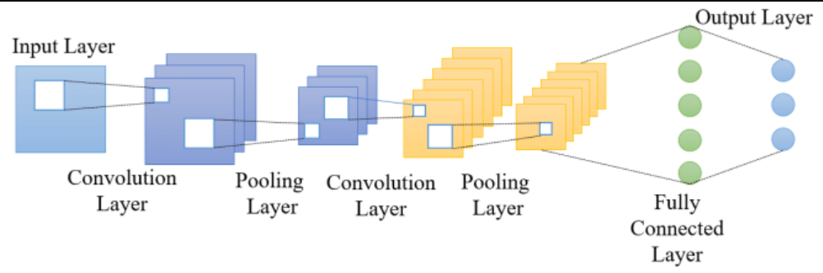
What is CNN?
Convolutional Neural Network is a Supervised Deep Learning algorithm that learns complex patterns from large amount of data.
CNN is most used in image recognition and classification problems, where it performs very well.
Basic CNN architecture consists of Input layer, Convolutional layer, Pooling layer, Flattening layer, Fully connected layer and output layer.

Slide 5
Aim:
Aim of this project is to Recognize speech emotions through Convolutional Neural Network with high accuracy.

Slide 6
Abstract:
In this project we have implemented a Convolutional Neural Network model to recognize these emotions: Calm, Happy, Sad, Angry, Fearful.
The datasets used is the famous English dataset for Speech Emotion recognition:
RAVDESS(Ryerson Audio-Visual Database of Emotional Speech and Song)
This project achieves a mean accuracy of 94% on validation.

Slide 7
Literature review:
S.NO | AUTHOR | TITLE | TECHNIQUES USED | MERITS | DEMERITS
1 | Mrunal Prakash Gavali, Abhishek Verma | Automatic Recognition of Emotions in Speech With Large Self-Supervised Learning Transformer Models, 2023. | Transformer model | Accuracy 88% | Requires high computing resources.
2 | Harish P, Jeevagan J, Dr. Mercy Paul Selvan, Dr. A. Viji Amutha Mary, Dr. S. Jancy | Human Emotion Recognition by Audio Signals using MLP Classifier, 2023. | Multi layer perceptron | Fast to train the MLP model. | Low accuracy in prediction.
3 | Baby Shamini P , P. Girish Sai Varma, P. Ahammad Khan, D. Harshith Reddy | Speech Emotion Recognition Using DeepLearning, 2023. | Natural Language Processing | Good in generalizing prediction. | Takes a lot of time to train, and to run.

Slide 8
S.NO | AUTHOR | TITLE | TECHNIQUES USED | MERITS | DEMERITS
4 | Siyuan Shen, Yu Gao, Feng Liu, et al., | Emotion Neural Transducer for Fine-Grained Speech Emotion,2024 | Transducer model | Works good even we have small dataset | Model size is high.
5 | Sarthak N Atkar, Rahul Agrawal, Chetan Dhule, Nekita Chavan Morris, et al., | Speech Emotion Recognition Using Dialogue Emotion Decoder, 2023. | Dialogue Emotion Decoder | Good in general predictions. | Training time is high.

Slide 9
Existing System:
Various machine learning algorithms have been applied to categorize discrete emotions.
Recurrent Neural Networks (RNN).
Ranking Support Vector Machine(SVM).
Dimensionality Reduction Method.
These methods accuracy is between 80% to 90%.
Which can be increased.

Slide 10
Proposed System:
The proposed system uses Convolutional Neural Network for classifying emotions.
Dataset used for training is RAVDESS which is the standard dataset for Speech Emotion Recognition.
The feature used to train was MFCC(Mel Frequency Cepstral Coefficient) of the audio file.
Proposed system yields an average accuracy of 94%.

Slide 11
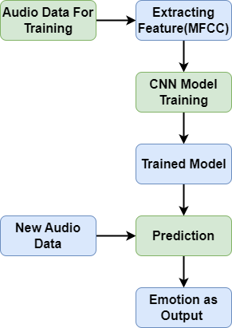
Proposed System Architecture:

Slide 12
System Requirements:
Hardware requirements:
CPU: Intel Core i-7, 1.80GHZ onwards
GPU : NVIDIA GEFORCE 5 MX130
System Type : 64-bit OS, x-64 based processor
RAM : 16 GB
Hard Disk : 1 TB
Software requirements:
Operating System : Windows 10
Platform : Jupyter Notebook
Machine learning framework : Keras & Tensorflow
Programming language : Python 3.9 or higher
Numerical calculation library : NumPy
Data manipulation library : Pandas
Data visualization library : Matplotlib
Audio library : Librosa

Slide 13
Implementation:
System implementation consists of five modules which are listed below:
Data Gathering.
Data Preprocessing.
Feature Selection and Feature Extraction.
CNN model building and training.
Prediction and Validation.

Slide 14
Data Gathering:
We have used the RAVDESS(Ryerson Audio-Visual Database of Emotional Speech and Song) which is the standard dataset for SER.
Data set consists of around 1500 audio files spoked by 24 actors(12 male, 12 female) with five emotions Happy, Calm, Angry, Sad and Fearful.
Each audio file name has an unique identifier at the 6th position that tells the emotion of that audio.
If the last character in the file name is odd it is male if it is even then it is female.
Ex 03-02-01-05-01-02-03.wav

Slide 15
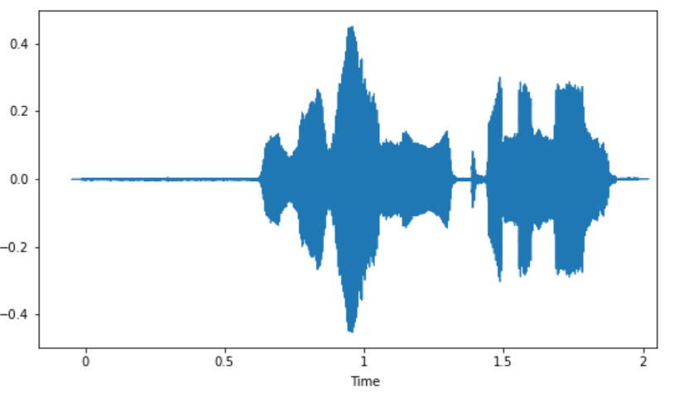
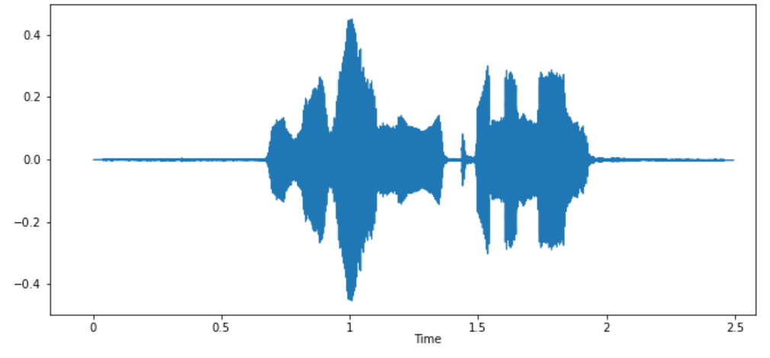
Data Preprocessing:
Data Preprocessing is a method to fill the missing values in the datasets.
Duration of each audio file is between 2 to 3 seconds. We need 2.5 seconds of audio data, so audio files with 2 seconds needs to be converted to 2.5 seconds.
This 0.5 seconds is the missing values and we filled this with value 0 which means no sound at the end.
Before
After

Slide 16
Feature Selection and Feature Extraction:
We have used Mel-frequency cepstral coefficients of the audio file as the feature for training.
MFCC is the most widely used training feature in many speech processing applications.
Librosa is an audio processing library in python, we have used it to extract MFCC of audio.

Slide 17
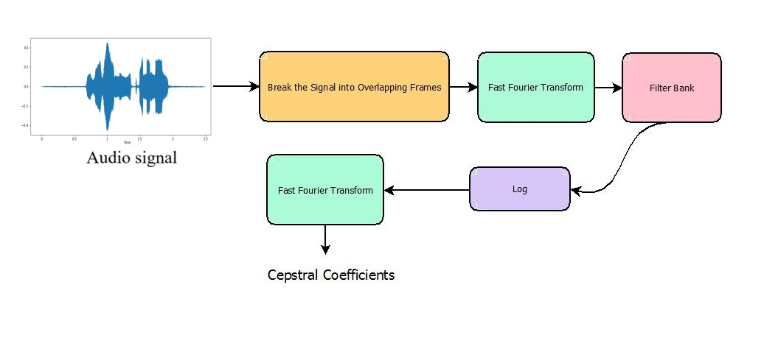
MFCC EXTRACTION

Slide 18
CNN Model Building and Training:
The dataset is splitted into 80:20 ratio. 80% data (951) for training and 20% data (249) for testing.
Our CNN architecture has totally 18 layers.
Input layer is the MFCC of the audio, which is 216 float values.
Each 1 dimensional Convolution layer has ReLu activation function.
We also added to two dropout layer to prevent overfitting to the training data.
The model trained with 700 epochs with 16 batch.
Total trainable parameters in our CNN is 528,266.

Slide 19
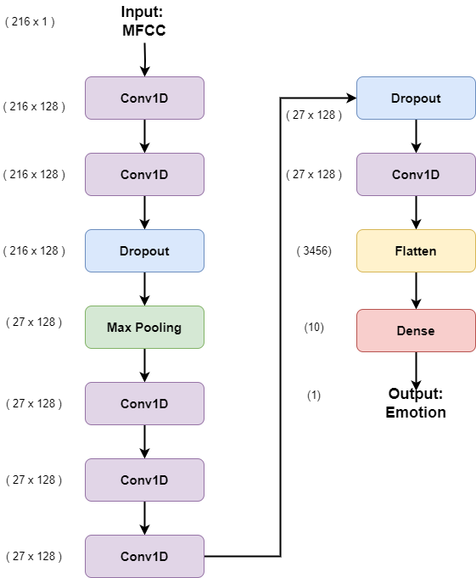
CNN Architecture

Slide 20
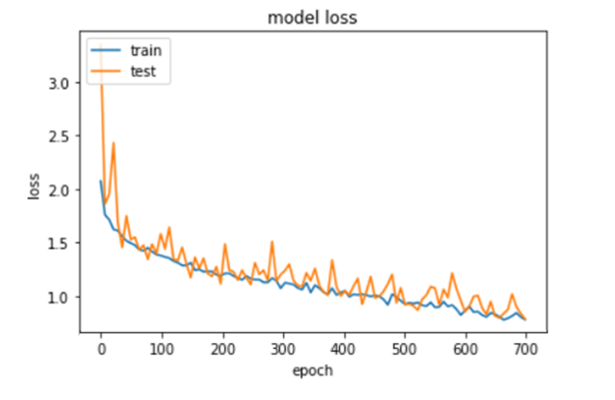
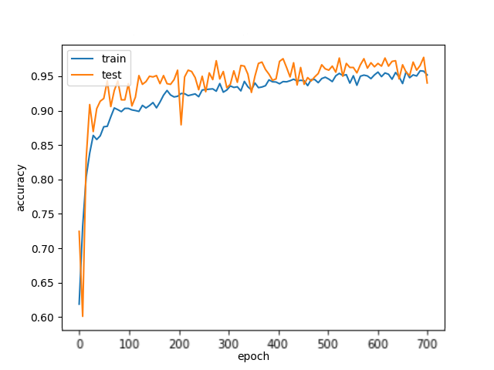
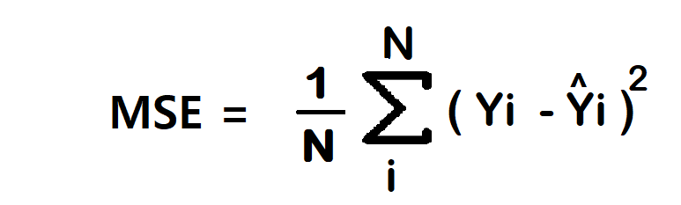
Loss and Accuracy:
Loss with Epochs
Accuracy with Epochs
NO OF CORRECT PREDICTIONS
ACCURACY =
NO OF DATASET

Slide 21
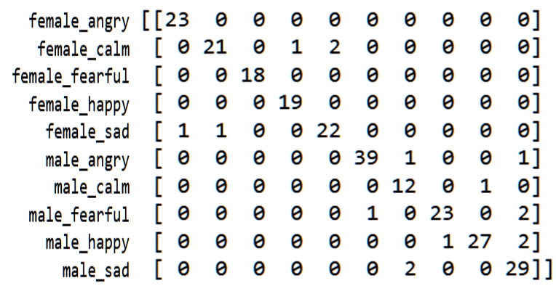
Making Predictions and Validation:
The trained model is then validated with the test data set with 249 audio files.
In the validation the model achieved overall accuracy of 94%.
FA FC FF FH FS MA MC MF MH MS
FA
FC
FF
FH
FS
MA
MC
MF
MH
MS
CONFUSION MATRIX

Slide 22
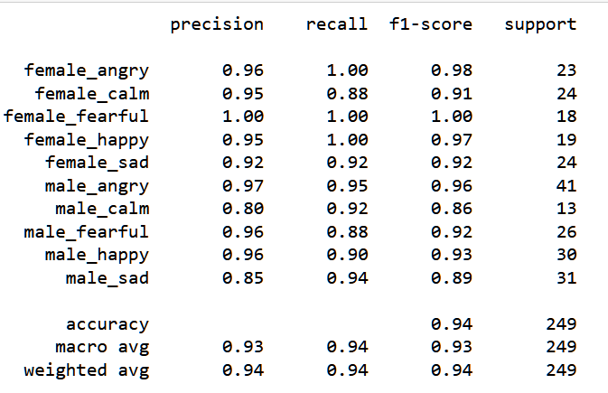
CLASSIFICATION REPORT

Slide 23
Conclusion & Future Work:
After experimenting with various sizes of layers and trainable parameters this project found this particular CNN model yields average accuracy of 94%.
This CNN model can be further developed to recognize emotions in many languages and to increase even more accuracy and training speed.

Slide 24
PROJECT EXECUTION

Slide 25
References:
Abhishek Verma, Mrunal Prakash Gavali(2023), ‘Automatic Recognition of Emotions in Speech With Large Self- Supervised Learning Transformer Models’
Harish P, Jeevagan J, Dr. Mercy Paul Selvan, Dr. A. Viji Amutha Mary, Dr. S. Jancy(2023), ‘Human Emotion Recognition by Audio Signals using MLP Classifier’
P.Baby Shamini, P. Girish Sai Varma, P. Ahammad Khan, D. Harshith Reddy(2023), ‘Speech Emotion Recognition Using Deep Learning’
Francesco Ardan Dal Rí, Fabio Cifariello Ciardi, Nicola Conci (2023), ‘Speech Emotion Recognition and Deep Learning: An Extensive Validation Using Convolutional Neural Networks’
Sarthak N Atkar, Rahul Agrawal, Chetan Dhule, Nekita Chavan Morris, Pranay Saraf, Kamlesh Kalbande(2024), ‘Speech Emotion Recognition Using Dialogue Emotion Decoder and CNN Classifier’
Siyuan Shen, Yu Gao, Feng Liu, Hanyang Wang, Aimin Zhou(2024), ‘Emotion Neural Transducer for Fine-Grained Speech Emotion Recognition’

Slide 26

Any Questions?

Slide 27
THANK YOU

